Slide 1
Lesson Objectives
List the relative charges and masses of protons, neutrons and electrons State that the atom has a dense, positively charged nucleus consisting of protons and neutrons, around which move negatively charged electrons. State that an element is identified by its atomic number (Z) which determines the number of electrons in a neutral atom of the element. Define the mass number (A) of an atom as the total number of protons and neutrons in the nucleus of an atom. Define isotopes as atoms with the same number of protons and different numbers of neutrons. Explain the existence of isotopes in terms of the neutron content of the nucleus.

Slide 2
Atomic Structure & Sub-atomic Particles

Slide 3
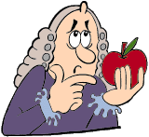
Sub-atomic particles
3 kinds of sub-atomic particles:
Protons
Neutrons
Electrons
Inside the condensed nucleus
Moving around the nucleus
Let's Think 1

Slide 4
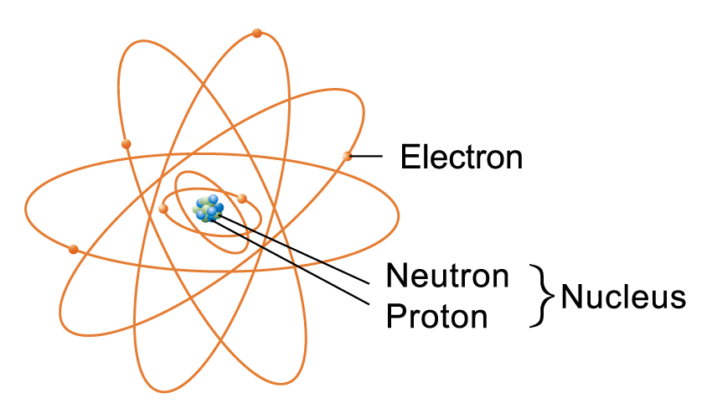
A carbon-12 atom

Slide 5
Characteristics of sub-atomic particles
Sub-atomic particle | Proton | Neutron | Electron
Symbol | p or | n or | e⁻ or
Location in atom | Nucleus | Nucleus | Surrounding the nucleus
Relative charge | +1 | 0 | -1
Actual mass (g) | 1.7 × 10⁻²⁴ | 1.7 × 10⁻²⁴ | 9.1 × 10⁻²⁸
Approximate relative mass (a.m.u.) | 1 | 1 | 0 (approx. 1/2000)
1
H
1
n
0
e
1
0
-1

Slide 6
1 a.m.u. = 1/12 of the mass of a C-12 atom
One C-12 atom has 6 p, 6n and 6e⁻
mass of e⁻ can be ignored
mass of a C-12 atom ≈ 6p + 6n
mass of p ≈ mass of n
mass of a C-12 atom ≈ 6p + 6n ≈ 12p ≈ 12n
mass of p ≈ mass of n ≈ 1 a.m.u.

Slide 7
Lesson Objectives
List the relative charges and masses of protons, neutrons and electrons State that the atom has a dense, positively charged nucleus consisting of protons and neutrons, around which move negatively charged electrons. State that an element is identified by its atomic number (Z) which determines the number of electrons in a neutral atom of the element. Define the mass number (A) of an atom as the total number of protons and neutrons in the nucleus of an atom. Define isotopes as atoms with the same number of protons and different numbers of neutrons. Explain the existence of isotopes in terms of the neutron content of the nucleus.

Slide 8
Express the masses of the following isotopes in a.m.u..
12
~13 ~14

Slide 9
Atomic Number & Mass Number

Slide 10
Atomic number
The atomic number (Z) of an element is the number of protons contained in the nucleus of the atom.
Atoms are electrically neutral
Atomic number
Number of protons
Number of electrons
=
=

Slide 11
Mass number
The mass number (A) of an atom is the sum of the number of protons and neutrons in the nucleus.
Mass number
Number of protons
Number of neutrons
=
+
Number of neutrons = Mass number – Atomic number

Slide 12
Isotopes
Isotopes are atoms of the same element with the same number of protons but different numbers of neutrons. Or
Isotopes are atoms of the same element with the same atomic number but different mass numbers

Slide 13
Notation for an isotope
Mass number
Symbol of the element
Atomic number

Slide 14
Atomic number
Mass number
No. of electrons
No. of neutrons
Notation
Number of protons
5
10
8
8
9
28
14
10
12
78
44
66
30

Slide 15
Atomic number
Mass number
No. of electrons
No. of neutrons
Notation
Number of protons
5
10
5
5
5
8
17
8
8
9
14
28
14
14
14
10
22
10
10
12
34
78
34
34
44
30
66
30
30
36
Learning Objective
From the relationship between atomic number and mass number, determine the number of protons, neutrons and electrons in an atom or monatomic ion. (can re-cap quick or do it in ionic bonding)

Slide 16
Lesson Objectives
List the relative charges and masses of protons, neutrons and electrons State that the atom has a dense, positively charged nucleus consisting of protons and neutrons, around which move negatively charged electrons. State that an element is identified by its atomic number (Z) which determines the number of electrons in a neutral atom of the element. Define the mass number (A) of an atom as the total number of protons and neutrons in the nucleus of an atom. Define isotopes as atoms with the same number of protons and different numbers of neutrons. Explain the existence of isotopes in terms of the neutron content of the nucleus.

